Slide 1
Chemical Equations

Slide 2
Balancing
Chemical Equations

Slide 3
Ca
Ca
N
N
N
N
O
O
O
O
O
O
O
O
O
O
O
O
O
O
O
O
H
H
H
H
H
H
H
H

Slide 4
Compounds | Left Side | Right Side
Ca | 1 | 1
N | 1 | 2
O | 3+2=5 | 3x2+1=7
H | 1 + 2=3 | 2
Compounds | Left Side Add/Del | Right Side Add/Del
Ca | 1 | 1
N | 1 x2 =2 | 2
O | 3x2+2=8 | 3x2+1x2=8
H | 1 + 2=3+1=4 | 2x2=4

Slide 5
Na
Na
Na
Na
S
S
O
O
O
O
O
O
O
O
O
O
O
O
H
H
H
H
H
H
H
H

Slide 6
Compounds | Left Side | Right Side
Na | 1 | 2
S | 1 | 1
O | 1+4=5 | 4+1=5
H | 1 + 2=3 | 2
Compounds | Left Side Add/Del | Right Side Add/Del
Na | 1x2=2 | 2
S | 1 | 1
O | 1x2+4=6 | 4+1x2=6
H | 1x2 + 2=4 | 2x2=4

Slide 7
Fe
Fe
Fe
Fe
Fe
Fe
O
O
O
O
O
O
O
O
H
H
H
H
H
H
H
H
H
H
H
H
H
H
H
H

Slide 8
Compounds | Left Side | Right Side
Fe | 1 | 3
O | 1 | 4
H | 2 | 2
Compounds | Left Side Add/Del | Right Side Add/Del
Fe | 1x3=3 | 3
O | 1x4=4 | 4
H | 2x4=8 | 2x4=8

Slide 9

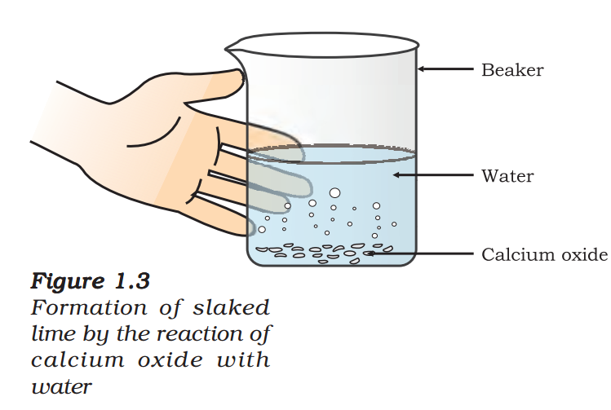
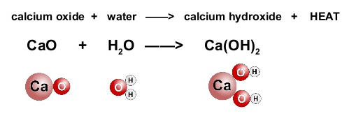
In this reaction, calcium oxide and water combine to form a single product, calcium hydroxide. Such a reaction in which a single product is formed from two or more reactants is known as a combination reaction.
Combination Reaction

Slide 10

when two or more substances (elements or compounds) combine to form a single product, the reactions are called combination reactions.
Combination Reaction
Burning of coal
Formation of water from H(g) and O(g)
ii)

Slide 11



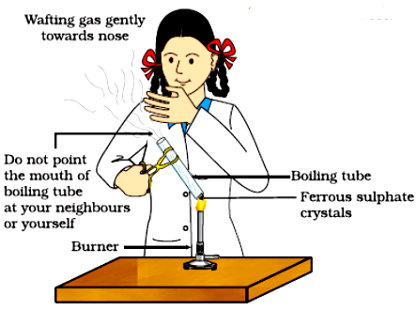
In this reaction you can observe that a single reactant breaks down to give simpler products. This is a decomposition reaction. Ferrous sulphate crystals (FeSO₄, 7H₂O) lose water,when heated and the colour of the crystals changes. It then decomposes to ferric oxide (Fe₂O₃), sulphur dioxide (SO₂) and sulphur trioxide (SO₃). Ferric oxide is a solid, while SO₃ and SO₂ are gases.
Decomposition Reaction
Correct way of heating the boiling tube containing crystals of ferrous sulphate and of smelling the odour
Decomposition of calcium carbonate to calcium oxide and carbon dioxide on heating is an important decomposition reaction used in various industries. Calcium oxide is called lime or quick lime. It has many uses – one is in the manufacture of cement. When a decomposition reaction is carried out by heating, it is called thermal decomposition.

Slide 12
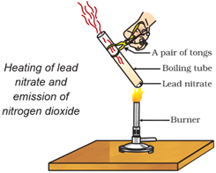
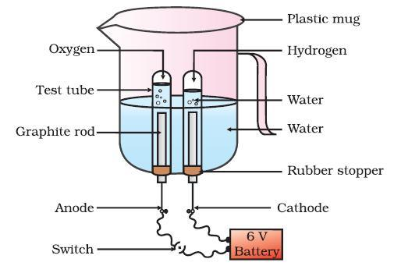

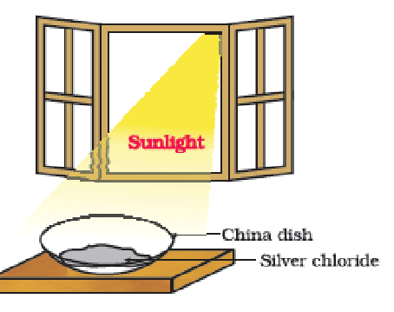
when two or more substances (elements or compounds) combine to form a single product, the reactions are called combination reactions.
Decomposition Reaction
Combination Reaction
Another example of a thermal decomposition reaction
You will observe the emission of brown fumes.
These fumes are of nitrogen dioxide (NO₂). The reaction that takes place is Decomposition Reaction.
Burning of coal
Formation of water from H(g) and O(g)
ii)
II. Electrolysis of Water
white silver chloride turns grey in sunlight.
This is due to the decomposition of silver chloride into silver and chlorine by light

Slide 13
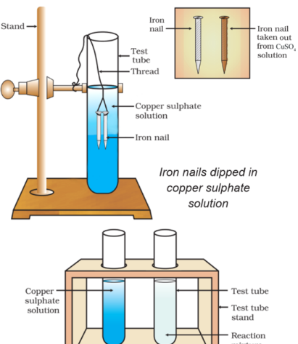
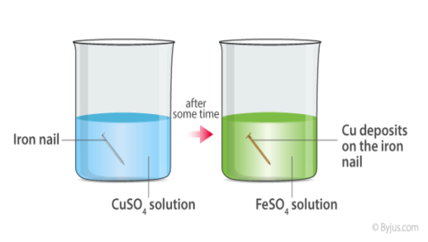
Displacement Reaction
In this reaction, iron has displaced or removed another element, copper, from copper sulphate solution. This reaction is known as displacement reaction
Other Examples for Displacement Reactions
Zinc and lead are more reactive elements than copper. They displace copper from its compounds

Slide 14
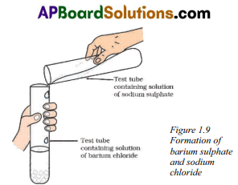
Double Displacement Reaction
You will observe that a white substance, which is insoluble in water, is formed. This insoluble substance formed is known as a precipitate. Any reaction that produces a precipitate can be called a precipitation reaction
What causes this? The white precipitate of BaSO₄ is formed by the reaction of SO₄ and Ba²⁺ . The other product formed is sodium chloride which remains in the solution. Such reactions in which there is an exchange of ions between the reactants are called double displacement reactions.

Slide 15
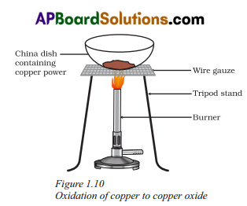
Oxidation Reduction
The surface of copper powder becomes coated with black copper(II) oxide. This is because oxygen is added to copper and copper oxide is formed.
If hydrogen gas is passed over this heated material (CuO), the black coating on the surface turns brown as the reverse reaction takes place and copper is obtained
If a substance gains oxygen during a reaction, it is said to be oxidised. If a substance loses oxygen during a reaction, it is said to be reduced
In the second reaction the copper oxide is losing oxygen and is being reduced. The hydrogen is gaining oxygen and is being oxidised. In other words, one reactant gets oxidised while the other gets reduced during a reaction. Such reactions are called oxidation reduction reactions or redox reactions.

Slide 16
Oxidation Reduction
Oxidation
Reduction
Some other examples of redox reactions are:

Slide 17
Oxidation Reduction
Corosion
Observed that iron articles are shiny when new, but get coated with a reddish brown powder when left for some time. This process is commonly known as rusting of iron. Some other metals also get tarnished in this manner. Have you noticed the colour of the coating formed on copper and silver? When a metal is attacked by substances around it such as moisture, acids, etc., it is said to corrode and this process is called corrosion. The black coating on silver and the green coating on copper are other examples of corrosion.
Corrosion causes damage to car bodies, bridges, iron railings, ships and to all objects made of metals, specially those of iron. Corrosion of iron is a serious problem.

Slide 18
Oxidation Reduction
Rancidity
Have you ever tasted or smelt the fat/oil containing food materials left for a long time? When fats and oils are oxidised, they become rancid and their smell and taste change. Usually substances which prevent oxidation (antioxidants) are added to foods containing fats and oil. Keeping food in air tight containers helps to slow down oxidation. Usually that chips manufacturers usually flush bags of chips with gas such as nitrogen to prevent the chips from getting oxidised .

